Slide 1




SMART INDIA HACKATHON 2024
Problem Statement ID : 1638
Problem Statement Title : AI-Driven Crop Disease Prediction and Management System
Theme : Agriculture, FoodTech & Rural Development
PS Category : Software
Team ID : AIML 06
Team Name : Xception Endeavours
Team Members :
Suryaprakash S - 22AM062 Kishore Balaji B - 22AM031
Sanjai M - 22AM053 Saarathy Mithran R S - 22AM051
Manibharathi R - 22AM034 Kavya Shree V - 22AM030

Slide 2














CROP CARE
PROPOSED SOLUTION
A DL model for predicting the disease class of leaf image and building Web and Mobile Applications using that model.
Our Solution
The Model enables early detection of diseases accurately before they devastate crops, preventing large-scale yield losses.
Problem Solving
Innovation & Uniqueness
Xception Model is used for accurately detecting images, as it performs depthwise and pointwise convolutional.
Notes:
2

Slide 3

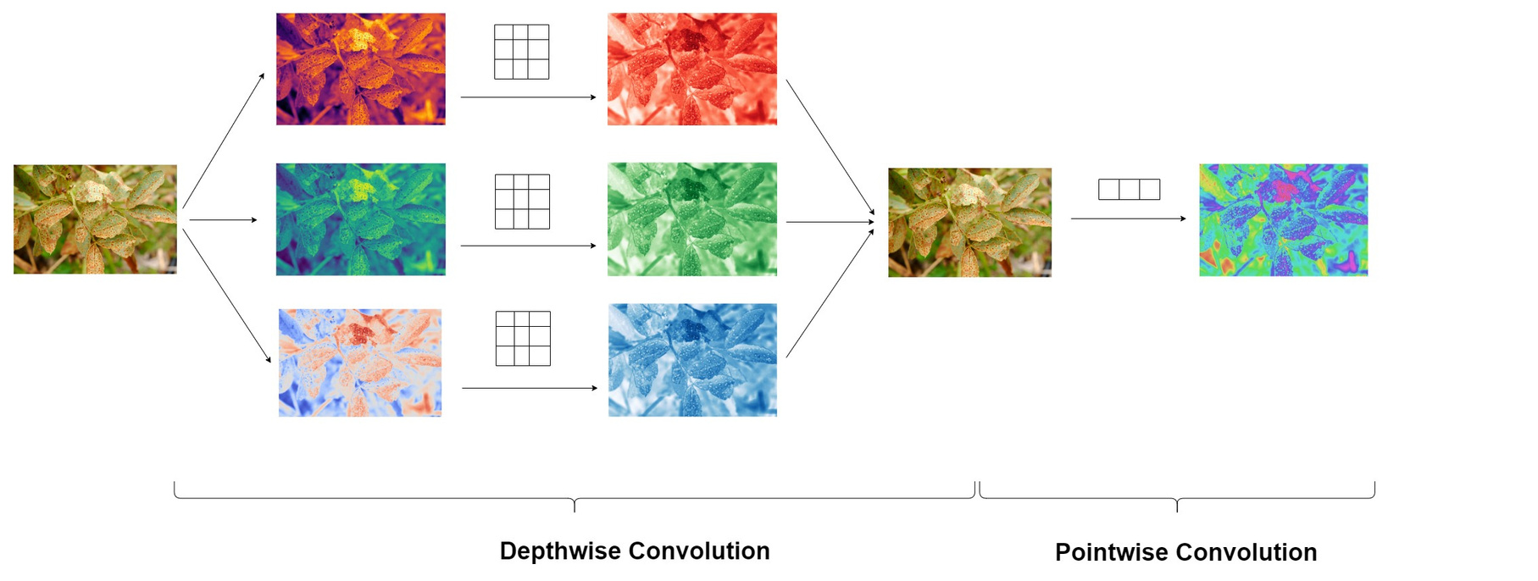




XCEPTION ARCHITECTURE
01
More efficient due to depthwise separable convolutions.
02
Reduces model size and complexity.
03
Often outperforms traditional models in image tasks.
04
Suitable for both mobile and large-scale applications.
Xception is a deep convolutional neural network architecture that improves upon the Inception model by using depthwise separable convolutions.
In Xception, the convolution operation is split into two parts: depthwise convolution, which filters spatial information separately for each channel, and pointwise convolution, which combines the outputs across channels.
Xception achieves high performance while being computationally efficient, and it has been widely used in image classification tasks

Slide 4








FLOW CHART & TECHNICAL STACK
Data Acquisation
Tensorflow Dataset
TECH STACK
Preprocessing (Image Resizing, Augmentation, etc.)
Xception Model
FastAPI Backend (TF Serving)
GCP Functions (TFLite Model)
Model Deployment
Web App (React.js)
Mobile App (React NatIve)
Recommendation Engine (Treatment & Prevention)
Real-Time Insights (Notifications)
Notes:
3

Slide 5

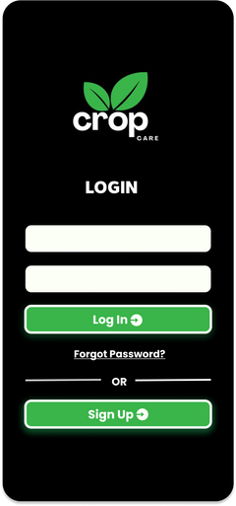
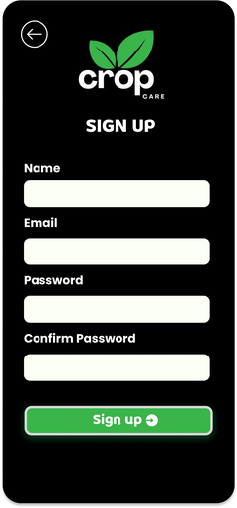
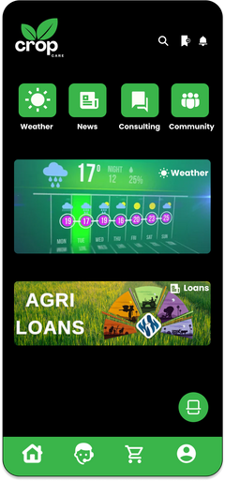
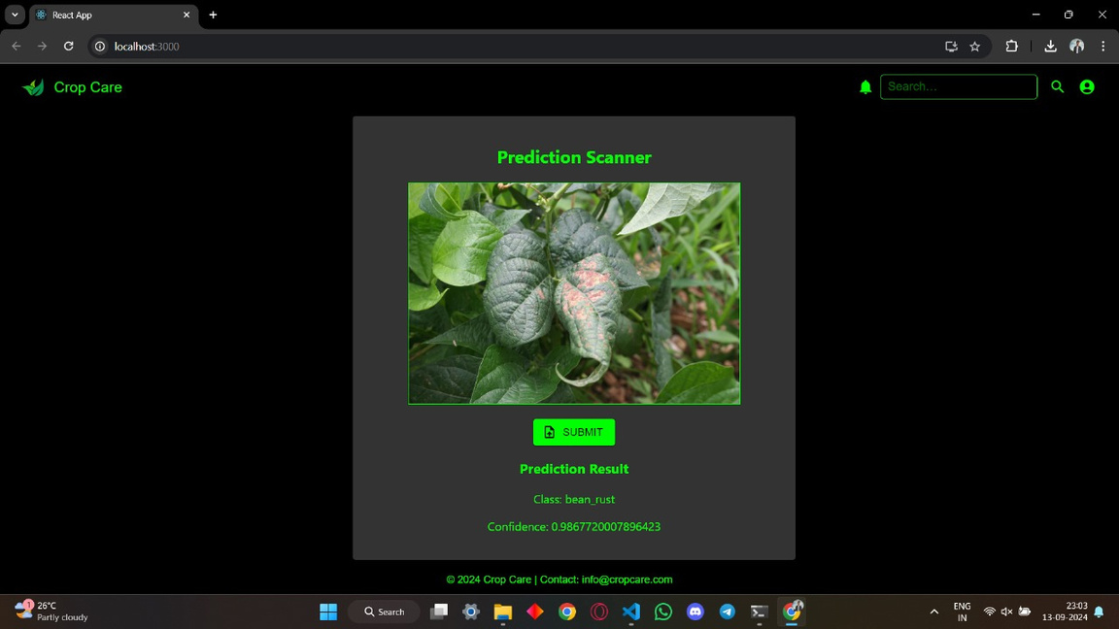
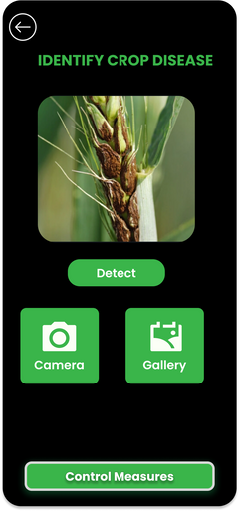
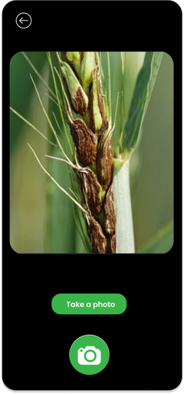
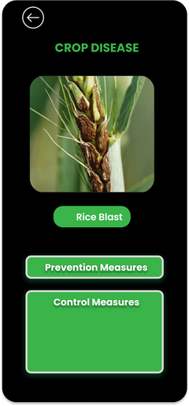
PROTOTYPE
b) Web Application
a) Mobile Application

Slide 6

FEASIBILITY AND VIABILITY
FEASIBILITY
VIABILITY
Ease of Access:
Farmers can easily access the app via smartphones or computers.
Cost Savings:
Reduces costs by preventing unnecessary treatments.
01
Localized Functionality:
Region-specific predictions ensure relevance to local crops.
Improved Crop Yields:
Boosts crop yields through early disease intervention.
02
Simple User Interface:
Simple interface makes it easy for non-tech-savvy users.
03
Time Efficiency:
Saves time with quick, actionable insights.
Scalable Platform:
Scalable design supports various crops and farming regions.
Personalized Recommendations:
Offers personalized recommendations for
specific crops.
04
Support and Training:
Provides customer support and tutorials for easy onboarding
Sustainable Farming:
Promotes sustainable farming with preventive
measures.
05

Slide 7




IMPACT AND BENEFITS
Impact
Benefits
Early detection of diseases helps farmers to protect their crops more effectively, reducing the spread of infections.
Our model helps farmers to find the correct treatment.
It helps in identifying crop diseases that have similar symptoms but require different treatment.
Proactive disease management and user-friendly interface for easy accessibility.
It helps for increased crop production and food security.
Early preventive measures for diseases
Helps farmers optimize the use of resources like water, pesticides, and fertilizers
Makes farming more profitable and efficient.
RESEARCH &
REFERENCES
https://jesit.springeropen.com/articles/10.1186/s43067-024-00137-1
https://www.mdpi.com/2079-9292/10/12/1388
https://www.ncbi.nlm.nih.gov/pmc/articles/PMC8779777/
https://www.frontiersin.org/journals/plant-science/articles/10.3389/fpls.2023.1230886/full
Notes:
5

